Slide 1


Development and Prospectus of Interest Free Banking in Ethiopia
Frezer Ayalew, Director, Supervision, NBE
August 2026
Notes:
Types of riba
History in beginning
Present landscape of Islamic Banking

Slide 2
Contents
The Financial System Landscape
Financial System Reform
Strategic Position and Direction of IFB in the Financial System
Evolution of the IFB Regulatory Framework
Current Performance of IFB in Ethiopia
IFB Products and Services
Challenges
Key Initiatives in Pipeline

Slide 3
The Financial System Landscape in Ethiopia
Pillars of the Financial System include:
Financial Market (Financial Institutions & Capital Mkt)
FIs= Banks, MFIs, Ins Cos, CGFCs, PIIs, PSO etc.
Capital Mkt: Capital Market Proclamation ratified, CMRA established and ESX has gone operational, various capital market service providers are licensed and in operation.
Payment and Settlement System (Financial Infrastructure)
Regulatory Bodies (NBE, AABE, FIS, EDIF, CMRA)
Financial Consumers.

Slide 4
Financial System Reform in Ethiopia
NBE monetary policy modernization.
Banking sector opening up for foreign investment.
New NBE proclamation and banking business proclamation enacted.
Establishment of CMRA and ESX – ESX Launched on January 09, 2025.
Ethiopian Deposit Insurance Fund operationalized.
New FX Policy Regime - Competitive and Market Based FX policy introduced.
Electronic interbank FX market powered by ESX introduced.
Rapid and exponential growth of DFS
Banking Business Legal Framework/Directives are being upgraded.

Slide 5
Strategic Position of IFB in The Financial System
Interest Free/Islamic Banking System Model:
  Pure Conventional
  Full-fledged
  Dual system
  Conventional plus system
In Ethiopia, the financial system has been dominated with conventional/traditional system where interest/riba plays dominant role.
Currently, Ethiopia is in a conventional plus system where there are few IFB under the conventional regulatory regime.
Going forward, dual system where all conventional and IFB operate side by side/in parallel with customized regulatory regime is in progress in all financial system actors.

Slide 6
Evolution of of Regulatory framework for IFB in Ethiopia
2008
Proc. No. 592/2008, art 22 (2) issued allowing
IFB as window
2011
Directives to License & Authorize the Business of Interest Free Banking Issued: (repealed)
2019
Amended Proc. No. 1159/2019, art 59 issued allowing licensing of standalone bank
2019
Directives to License & Authorize the Business of Interest Free Banking: SBB/72/2019 issued
2025
- Banking Business Proclamation Issued
- NIFS Strategy (Draft)

Slide 7
Banking Business Proclamation No. 1360/2025
Provided overarching legal framework for licensing and supervision of banks including IFBs.
IFB included and became part of banking business definition
IFB service defined as provision of banking service by full-fledged IFB and banks having IFB windows.
Opened the banking system (including IFBs) for foreign investment.
Article 82 specifically addresses Interest Free Banking Service.
NBE mandated to develop customized legal framework for supervising IFB service in respect of specific and peculiar maters.
NBE is empowered to prescribe additional conditions and requirements for licensing and supervision of interest-free banks and banks providing interest-free banking through windows.
The Proclamation also provides for regulation of the overall Shariah governance framework, including establishment of a Central Shariah Board.
Interest-free banking therefore sits within the national banking supervisory framework while receiving additional tailored requirements.

Slide 8
National Interest Free Finance (NIFFS) Draft
NIFFS is intended to provide a coordinated long-term direction for interest-free finance in Ethiopia.
2026 validation discussions emphasized financial inclusion, savings mobilization, access to finance, private-sector growth and economic modernization.
The strategy discussion also highlights the need for legal/regulatory alignment, implementation sequencing and capacity building.
Implementation will require coordination among regulators, financial institutions, government bodies, industry, fintechs, academia and development partners.
Given the substantial demand for IFF in Ethiopia and its potential to contribute to financial inclusion and other socio-economic objectives, comprehensive NIFFS development is underway.

Slide 9
Current Performance of IFB in Ethiopia
No. of full-fledged IF banks: 4
No of banks providing IFB through window: 24
Total deposit mobilized through IFB: ETB 567.1 Billion or USD 3.2B
No. of Deposit A/Cs: 33,037,3694
Total IFB financing: ETB 237.2B or USD 1.3B
No. of financing accounts: 86,074

Slide 10
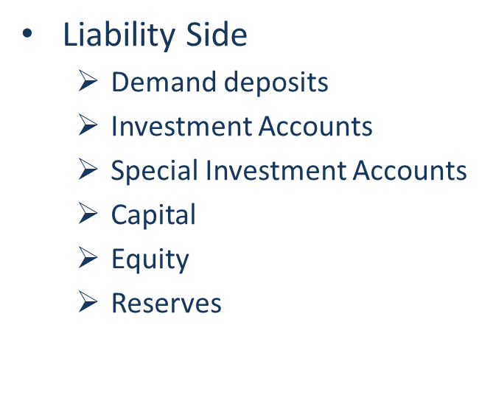
IFB Products and Services
Asset side
  Trade based financing
    Murabaha
    Musawama
    Salam
    Istisna
  Lease based
    Ijara
  Partnership based
    Mudaraba
    Musharaka
  Services based
    Wakala
    Kafala
    Juala

Slide 11
Challenges
Limited awareness and lack of adequate human capital on IFB.
Inadequate Sharia Governance Framework (central Sharia Advisory Board, Sharia Compliance, sharia audit).
Fund Segregation issues
Limited IFB product diversification.
Lack of customized but integrated regulatory framework for IFB.
Limited alignment to international standards such as IFSB and AAOIFI.

Slide 12
Key Initiatives In Pipeline
Finalize and implement NIFFS
Establishment of Central Sharia Advisory Board and introduction of robust SGF.
Developing and introduce distinct and customized regulatory framework
Introduce Shari’ah compliant liquidity management instruments e.g. discount window, lender-of-last-resort facilities, deposit insurance etc.
Development of adequate human capital with knowledge and relevant skills in IFB Business and supervision
Strengthen Islamic interbank markets.Explore Sukuk and other Islamic capital-market instruments.

